Slide 1
SUB. CODE: UIT1401
TITLE: PRINCIPLES OF SOFTWARE ENGINEERING
Prepared By: Dr.V.Arulkumar, Asst.Prof, IT

Slide 2
COURSE OBJECTIVES
● To understand the process and its models.
● To understand fundamental concepts of requirements engineering and Analysis Modeling.
● To understand the major considerations for enterprise integration and deployment.
● To learn various testing and maintenance measures.

Slide 3
COURSE OUTCOMES
● Identify the key phases in process models.
● Compare different process models.
● Apply the concepts of requirements engineering and Analysis modelling.
● Apply systematic procedure for software design and deployment.
● Compare and contrast various testing and maintenance.

Slide 4
SOFTWARE ENGINEERING: ANALYSIS AND DESIGN
What is Analysis and Design?

Slide 5

LECTURE OUTLINE
Defining Analysis and Design
Why do Analysis and Design?
Types of Analysis and Design
Requirements Engineering

Slide 6
DEFINITIONS
Many different definitions of the difference between analysis and design
In the past there was common agreement
  Was viewed as follows:
Description of the Problem
Description of the Solution
Essential
Model
Implementation
Model
Role of the Analyst
Role of the Designer

Slide 7




DEFINITIONS (2)
Structured Analysis and Structured Design
  different tools used to develop system
  often different teams used to do analysis and design
  clear distinction between tasks
  leads to the “Analysis/Design Wall”
analysis
design

Slide 8
DEFINITIONS (3)
With newer development methods, the divide between analysis and design breaks down
  the concept of seamlessness:
    an essential model is very difficult to develop without reference to implementation issues
  the increasing emphasis on requirements analysis
Some commentators see only
  Requirements Analysis
  High-level Design
  Low-level Design

Slide 9
DEFINITIONS (4)
Systems Analysis
  Process of
    defining a problem
    gathering the requirements
    developing an analysis model representing those requirements
  Describing the problem the system is meant to solve
Systems Design
  Process by which the analysis model is transformed into a model which is capable of being implemented
  Describing the solution to the problem

Slide 10
WHY DO ANALYSIS AND DESIGN?
Add formality
Reduce errors
Improve communication between participants
Get the requirements right!
The cost of fixing analysis and design errors as one moves from the analysis phase to the maintenance phase can increase by a factor of 100
Generate documentation

Slide 11
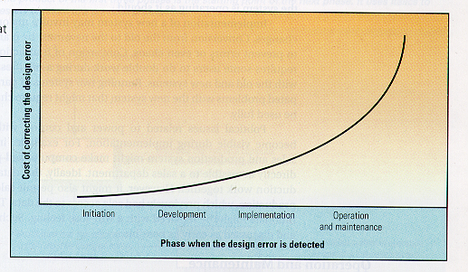
COST OF ANALYSIS/DESIGN ERRORS
NB: The XP people claim that this curve is no longer valid, when appropriate modern languages, patterns and databases are used. This is still a controversial claim.

Slide 12
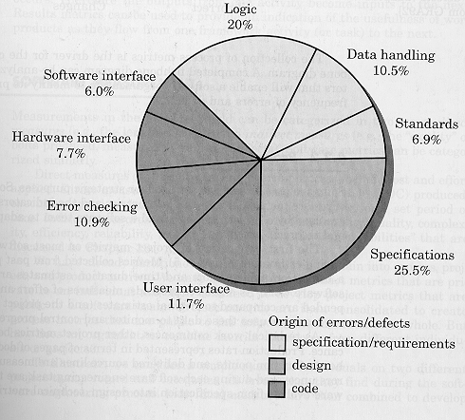
SOURCE OF ERRORS
Notes:
Source: Pressman
Specification/requirements/design: 63.7%
Code: 36.3

Slide 13
TYPES OF ANALYSIS/DESIGN
Top-down Analysis and Design
  Structured Analysis
  SADT
Object-Oriented Analysis and Design
  Object Modeling Technique (OMT)
  Booch OOA&D
  Unified Modeling Language (UML)
  OPEN/Mentor (Australian-based) Brian Henderson-Sellars and Object-Oriented Pty. Ltd.
Data-Driven Analysis and Design
  Jackson System Design
  Warnier-Orr Method

Slide 14
REQUIREMENTS ENGINEERING
Challenge facing system and software engineers
  How can we ensure that we have specified a system that:
    Properly meets the customer’s needs
    Satisfies the customer’s expectations
Requirements engineering provides mechanisms for:
  Understanding what the customer wants
  analyzing need
  assessing feasibility
  negotiating a reasonable solution
  specifying the solution
  validating the specification
  managing the transformation of the requirements into an operational system

Slide 15
REQUIREMENTS ENGINEERING
The requirements engineering process can be described in six steps:
  Requirements elicitation
  Requirements analysis and negotiation
  Requirements specification
  System modeling
  Requirements validation
  Requirements management

Slide 16
REQUIREMENTS ELICITATION
It might seem that this should be simple:
  Ask the customer, users, and others:
    What the objectives for the system are
    What is to be accomplished
    How the system fits the into the needs of the business
    How the system will be used on a day-to-day basis
In fact it is hard!
  Problems of scope
  Problems of understanding
  Problems of volatility

Slide 17
PROBLEMS OF SCOPE
The boundary of the system may be ill-defined
  Who is going to interact with the system?
  What other systems are involved?
  Exactly what functionality is the responsibility of the system
    e.g. should a rostering system produce a telephone directory?
The customer/user may specify unnecessary technical detail that may confuse overall system objectives
  e.g. specifying OS, language, hardware, etc. for no particularly good reason
Notes:
The rostering system/telephone directory example is from a real IE project I supervised (DMS). The task was to produce a roster for a radiology unit at Monash Medical Centre. The client noticed that the system had access to staff details (imported from another database!), and tried to get the production of a staff telephone directory added to the requirements for the rostering system.

Slide 18
PROBLEMS OF UNDERSTANDING
Customers/users may:
  Not be completely sure of what is needed, e.g.:
    “See what you can do to help us”
    (Marketing director of textile business)
    “Try to improve the project”
    (Director of British Aircraft Corporation, with reference to the Concorde project)
  Have a poor understanding of the capabilities and limitations of their computing equipment
  Not have a full understanding of the problem domain
  Have trouble communicating needs to system engineer
  Omit information believed to be “obvious”
  Specify requirements that conflict with needs of others
  Specify requirements that are ambiguous or untestable

Slide 19
PROBLEMS OF VOLATILITY
Requirements change over time
Change is inevitable in most systems, due to factors such as:
  Changes in customer organization, e.g.
    new divisions, new products
  Changes in scale, e.g.
    Number of transactions per day
    Number of users
    Increased connection bandwidth
  External changes
    Changes in law (e.g. taxation)
    Changes in international standards (e.g. MPEG)
  Customers get new ideas as they become aware of system possibilities

Slide 20
OVERCOMING REQUIREMENTS ELICITATION PROBLEMS
  Assess business and technical feasibility for the proposed system
  Identify the people who will help to specify requirements, and understand their organizational bias
  Define the technical environment in which the system will be placed:
    Computing architecture, operating system, telecommunications needs
  Identify “domain constraints” that limit system functionality or performance
    Characteristics of business environment specific to application domain

Slide 21
OVERCOMING REQUIREMENTS ELICITATION PROBLEMS (CONT.)
Define one or more requirements elicitation methods
  Interviews, focus groups, team meetings
Ensure that many people participate so that requirements are defined from different points of view
  Identify and record the rationale for each requirement
Identify ambiguous requirements as candidates for prototyping
  A means of addressing volatility
Create usage scenarios to help customers and users better identify key requirements
  e.g. Use Cases in OO A&D

Slide 22
PRODUCTS OF REQUIREMENTS ELICITATION PROCESS
The requirements elicitation process will produce work products to be included in the software configuration
  statement of need and feasibility
  bounded statement of scope for the system
  list of customers, users and other stakeholders who participated in requirements elicitation
  description of system’s technical environment
  list of requirements and their domain constraints
    preferably organized by function
  set of usage scenarios (under different operating conditions)
  any prototypes that were developed
All work products are reviewed by participants in requirements elicitation

Slide 23
REQUIREMENTS ANALYSIS AND NEGOTIATION
The products of requirements elicitation form the basis for requirements analysis
Requirements analysis
  Categorizes requirements
    Organizes them into related sub-sets
  Explores relationships between requirements
  Examines requirements for
    Consistency
    Omissions
    Ambiguity
  Prioritizes requirements based on customer/user needs
    May lead to plan for incremental development

Slide 24
REQUIREMENTS ANALYSIS QUESTIONS
Is each requirement consistent with the overall objective for the system?
Have all requirements been specified at the proper level of abstraction?
  i.e. not too much technical detail, or exclusion of future possibilities
Is each requirement really necessary?
  Or is it an add-on not needed for core system objective?
Is each requirement bounded an unambiguous?
Does each requirement have an attribution?
  Who or what is the source of the requirement?
Are there any conflicting requirements?
Is each requirement technically achievable in specified environment?
Is each requirement testable once implemented?

Slide 25
REQUIREMENTS NEGOTIATION
It is common for customers/users to ask for more than can be achieved
Also common for different stakeholders to proposed conflicting requirements
  e.g. cost requirement from management vs. performance requirement from users
  Each party might argue that their requirement is “essential”
Requirements engineer must resolve these conflicts through negotiation:
  Prioritize requirements, discuss conflicts in this order
  Identify risks associated with requirements
  Produce “guesstimates” of development effort for each requirement

Slide 26
REQUIREMENTS MANAGEMENT
We have noted that changes in requirements:
  are essentially unavoidable
  will persist throughout the lifetime of the system
Requirements management helps the project team to identify, track and control requirements and changes to them
  This is closely related to configuration management
Traceability tables are developed for requirements

Slide 27
TRACEABILITY TABLES
Features traceability table
  Show how requirements relate to customer-observable system features
Source traceability table
  Identify the source of each requirement
Dependency traceability table
  Show relationships between requirements
Subsystem traceability table
  Categorise requirements according to subsystems they govern
Interface traceability table
  Shows how requirements relate to internal and external system interfaces

Slide 28
REFERENCES
Pressman, R., Software Engineering: A Practitioner's Approach, McGraw-Hill, 2000 (Chapter 10).
Sommerville, I. and Sawyer, P., Requirements Engineering, Wiley, 1997.

